Slide 1
Estarta
Human Resources Management System
(esHRMS)

Slide 2
Human Resources Management System (HRMS)
The HRMS is a set of well-defined processes built to automate the internal organizational departments’ tasks related to the Human Resources, Finance, or IT departments.
The system as well enhances the communication between the employees and the organization departments in an automated way that is considered easy to track.
System was developed with usability at the core of the design focusing, yet offering the following strengths:-
System all inclusive (HR, Payroll, performance management, ….)
Secure due the sensitivity of the data transmitted across the system.
The flexibility to integrate with the attendance system over online or offline modes
Up-to-date with the Jordanian labor laws, social security department and taxation
Flexible and Customizable according to our clients business needs.
Scalability and reliability

Slide 3
Explore our esHRMS
Human Resources
Self Service Portal
Payroll & Finance
Analytics
IT Inventory
Notifications
System Administration

Slide 4
Human Resources Module
The Human Resources module is the module for the responsible HR Officer Role, where this officer organizes all the tasks related to employees personal and work information, manages vacations, annual expiry date, attendance, resignation and public holidays as well as job titles and divisions management. Following are the main functionalities related to the Human Resources module:
User Membership Account:
Dashboard
Inbox
Outbox
Public folder
Polls list
Employees Profiles:
New employee
Employees list
Resignation
Cars list
Back

Slide 5
Human Resources Module
Employees Attendance:
Attendance
Overtime management
Public holidays
Employees Performance:
Employees performance
Employees promotions
HR Administration Management:
Divisions and the organization tree
Lookups
Job titles
Analytics
General reports (employees info, gender, and nationalities)
Headcount reports (comers and leavers)
HR Matrix (the organization demographics)
Back

Slide 6
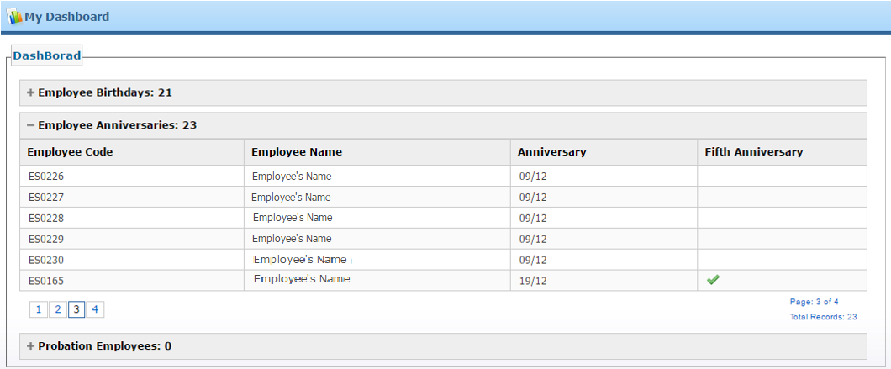
Human Resources Module
Human resources main features:
User Membership account: is the module for managing the user account in the login, logout, change password and accessing the main functionalities such as the dashboard, my inbox and my outbox, as well as the public folder and the polls list.
My Dashboard page is where the HR can have a quick view: employees’ birthdays, anniversaries, 5th anniversaries and probations
Back

Slide 7
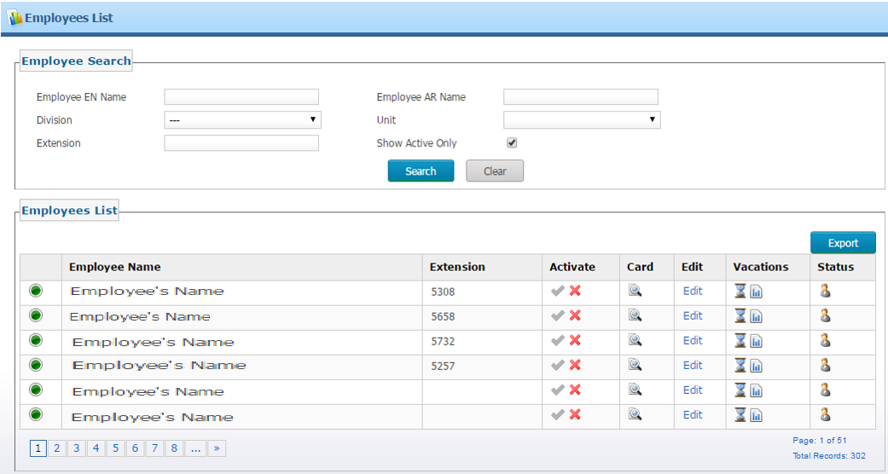
Human Resources Module
Employee Profiles: In this module the responsible user can manage all employees profiles by viewing all the added employees in the employees list, adding a new employee profile, managing the employees resignation process and the employees cars list
Back

Slide 8
Human Resources Module
Employee’s profile information tabs include: Basic info, education info, job titles info, contract info, certificates info, dependencies info and car information, in addition to the employee image and the official documents.
Back

Slide 9
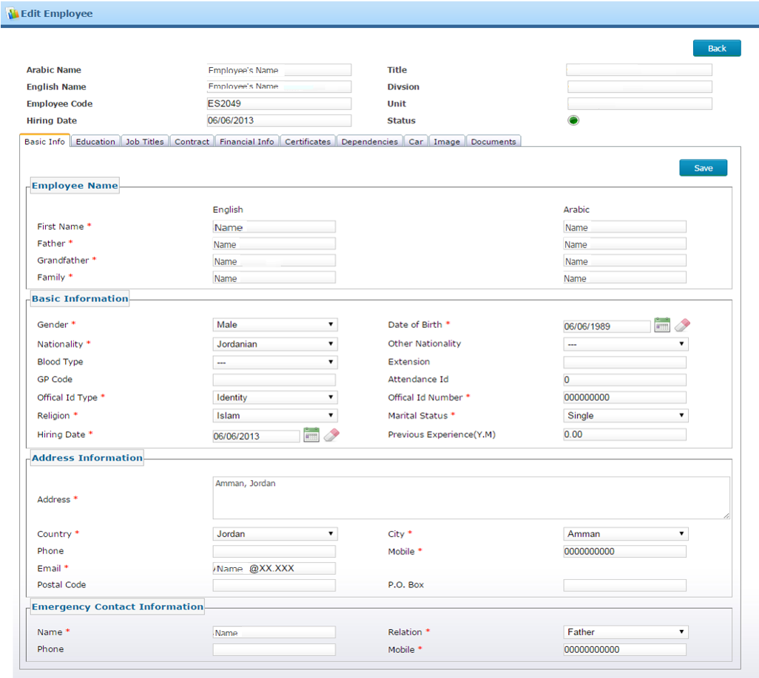
Human Resources Module
Back

Slide 10
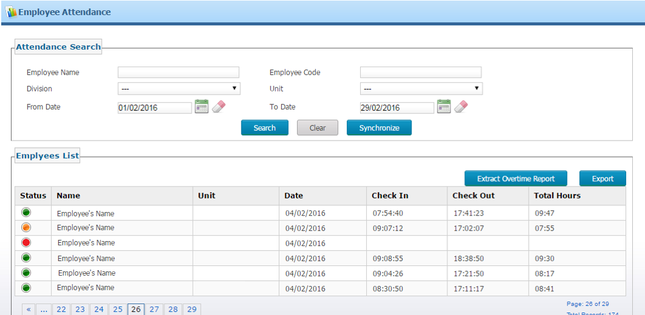
Human Resources Module
Employees Attendance module: is where the responsible user can check the attendance of all employees; it is integrated with the leaves module and enables the responsible user to search attendance for a specific employee in a specific date, check the leaves list, the public holidays and the overtime management
Back

Slide 11
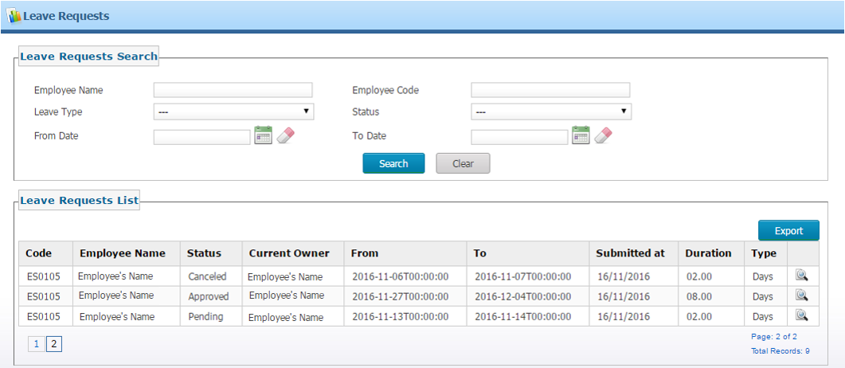
Human Resources Module
Leaves requests list: shows all the requested leaves and their statuses, the initiator name (employee name), current owner and the leave type
Back

Slide 12
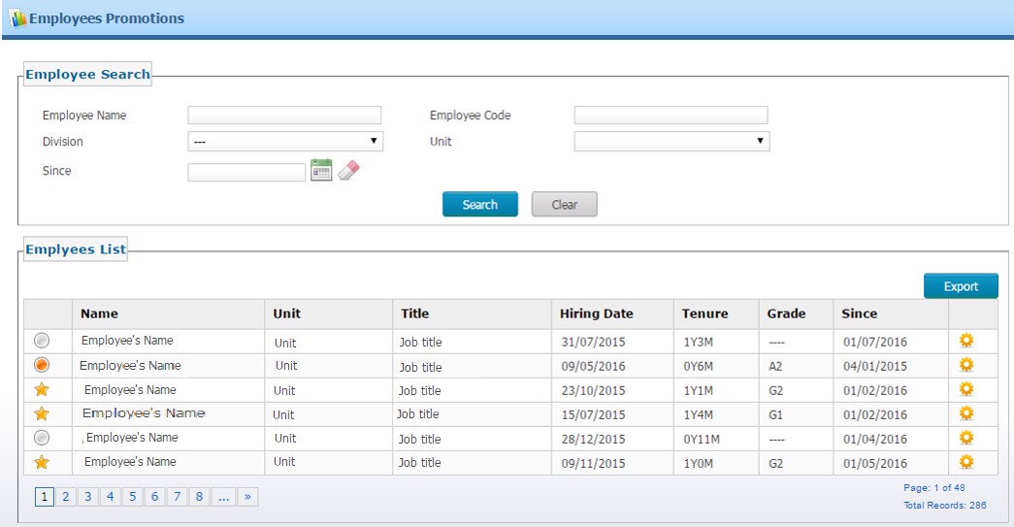
Human Resources Module
Employees performance:
Through this module the responsible user can manage each employee’s performance and promotions records
Both promotions and performance affect each other’s processes.
When executing the promotion, the performance record will be changed to the executed data
Back

Slide 13
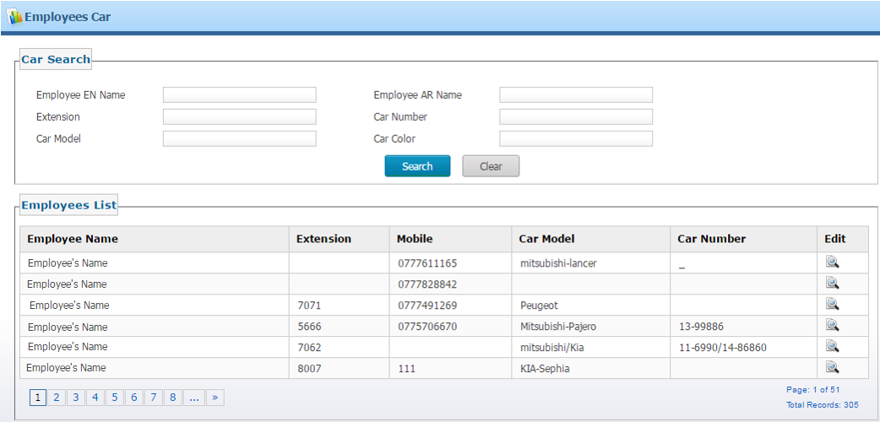
Human Resources Module
Back

Slide 14
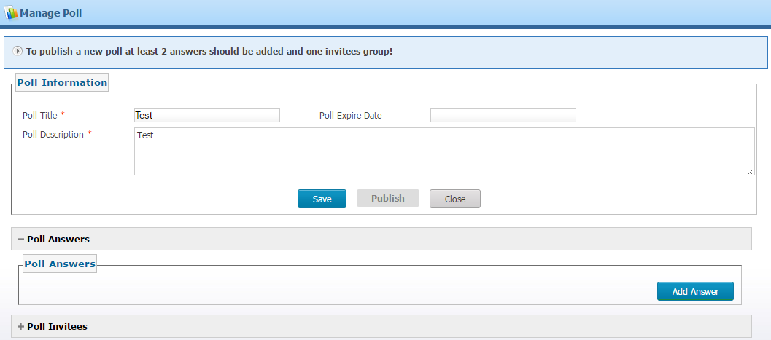
Human Resources Module
Polls list: is where the responsible user can create polls and their answers or options to be shared on the self service along with its specified expiry date, a date where voting can’t be made on the poll and the results displayed are final results
Back

Slide 15
Human Resources Module
Public folder: is where the responsible user can manage the shared documents by uploading documents, images and important files and editing and deleting them to be shared on the self service portal for all employees
Back

Slide 16
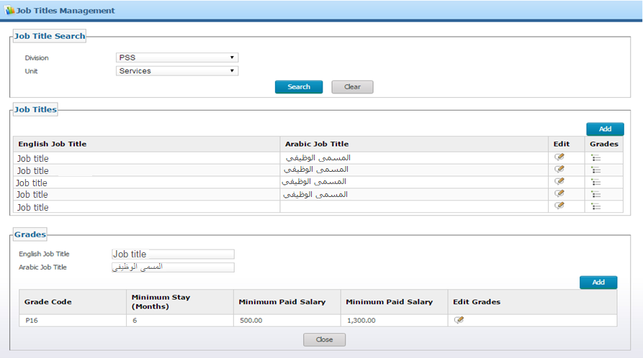
Human Resources Module
HR Administration: is where the HR can manage the Divisions and the units related to each division, job titles and the grades related to each job title.
Back

Slide 17
Human Resources Module
My inbox: shows the “assigned” tasks which the HR are responsible for their next action
My outbox: is the “initiated” tasks from the logged in account member, as the user can keep tracking the status of their tasks
The user has the ability to search the tasks by their type or status, and hide the non-pending tasks as well.
Back

Slide 18
Payroll and Finance
The Finance is the module for the responsible Payroll Officer Role, where this officer organizes all employee payment tasks and filing employees’ tax details. These tasks can include calculating salaries of each month, managing the payroll profile of each employee including the salary adjustment, deductions and additions, as well as viewing salaries lists and approving salaries. Following are the main functionalities related to the Payroll and the Finance module:
Payroll management
Additions
Deductions
Salary info
Resignation and maternity
Employees travels
Salary allocation
Calculate salary
Salary list
Back

Slide 19
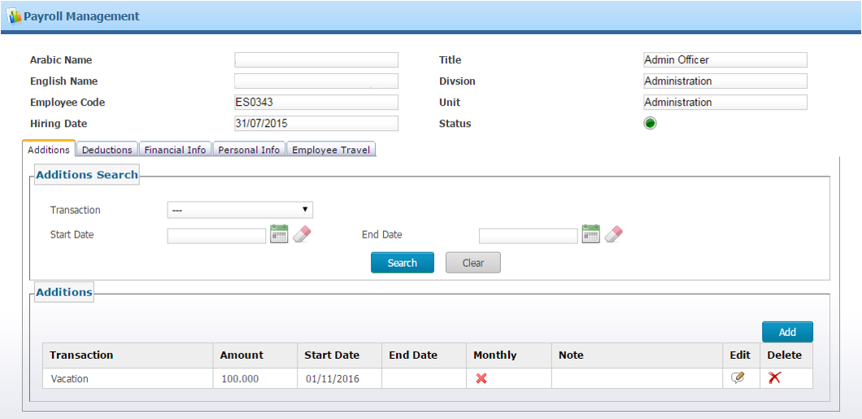
Payroll and Finance
Payroll management: This section enables the user responsible to manage the payroll profile of each employee including salary allocation management, salary adjustment, deductions and additions, as well as resignation, maternity and employee travel
Back

Slide 20
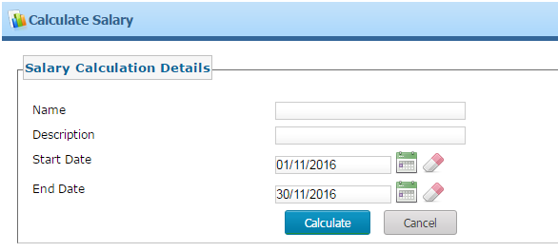
Payroll and Finance
Calculate salary: is where the responsible user can calculate the salary for a specific month by entering the name of this calculation, its description, the start, and end dates of the salary
Back

Slide 21
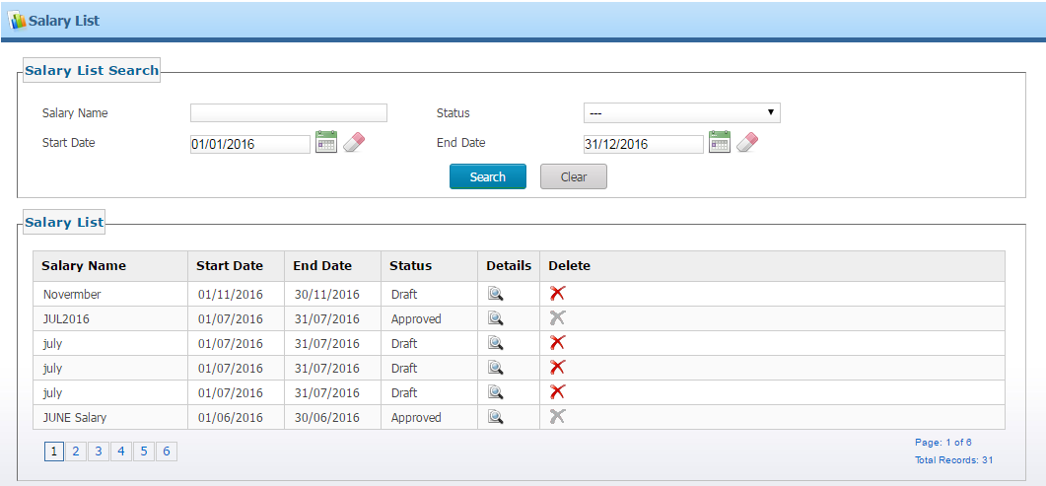
Payroll and Finance
Salary List: is where you can view all salaries, view their statuses, approve or reject salaries and delete a salary (only if the salary was in the Draft status).
Back

Slide 22
IT and Inventory
Inventory module: where the responsible user organizes all the tasks related to each employee items, devices and machines, views the history of inventory items and manages the different types of each inventory item and items management.
Following are the main functionalities offered by the IT and inventory module:
Employees inventory management
Inventory items management
Inventory items types management
Back

Slide 23
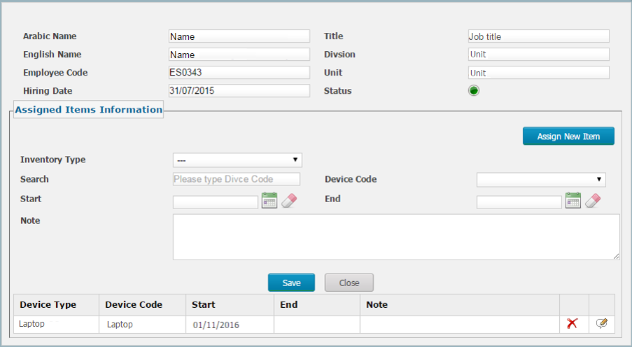
IT and Inventory
Employees inventory management module: is where the responsible user assigns inventory items to each employee, specifying the type, device code, start date and notes, in addition to viewing the items history of each employee and the action taken on each item.
Back

Slide 24
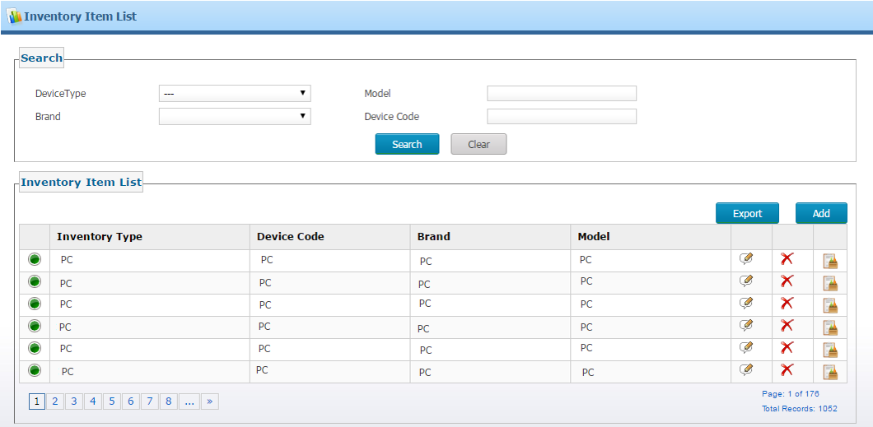
IT and Inventory
The inventory items management section: is where the responsible user manages all inventory items by adding new items to the list, editing an item information and viewing its history, in addition to the ability to search a specific item by its type, model, brand and code, as well as, export the list to an excel sheet.
Back

Slide 25
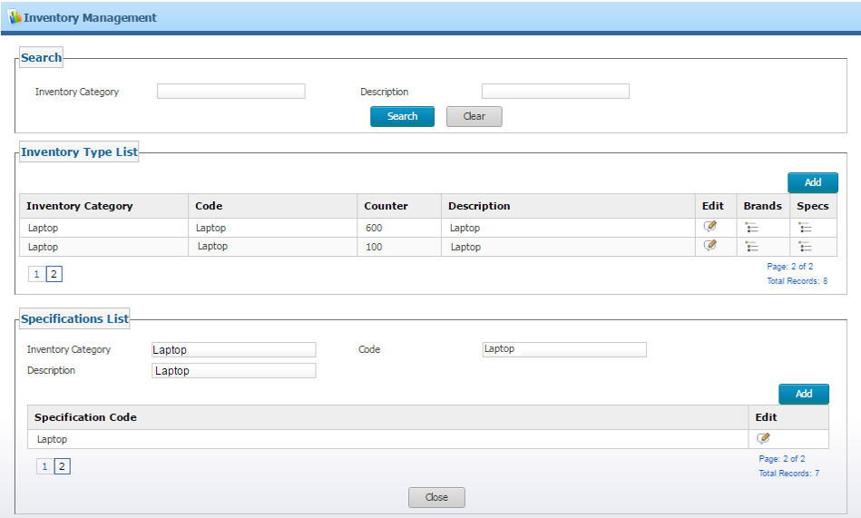
IT and Inventory
Inventory items types management section: is where the responsible user manages all inventory items types by adding a new category type and adding the brands and specifications of each one. In addition, the section provides the ability to search on a specific type by its category.
Back

Slide 26
System Administration
The Administration is the module that provides the HRMS administrators and operators with the main functionalities needed to manage the esHRMS Back Office and Self-service portals.
Following are the main functionalities related to the Administration module:
Users and Roles management
Back office users management
Self service users management
Settings management
System Logs details
Back

Slide 27
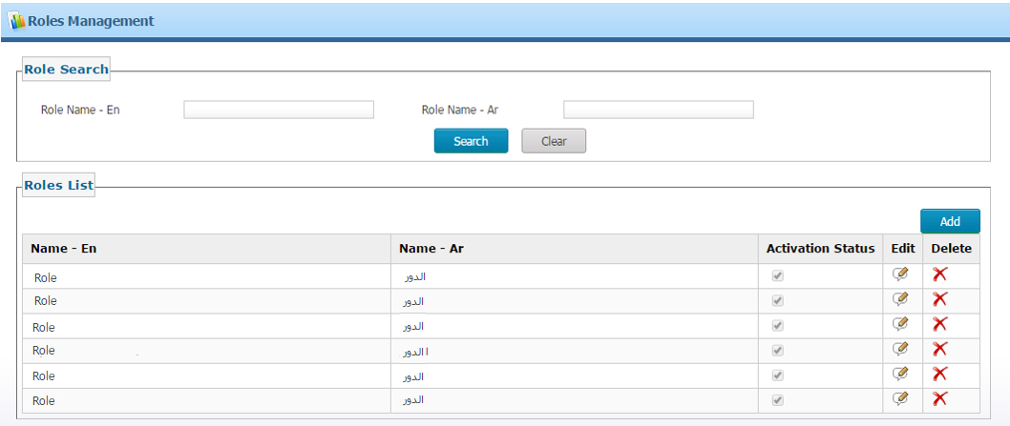
System Administration
Roles management module: is where the responsible user can manage the roles, e.g. add, edit, logically and physically delete the roles and search for certain roles.
Back

Slide 28
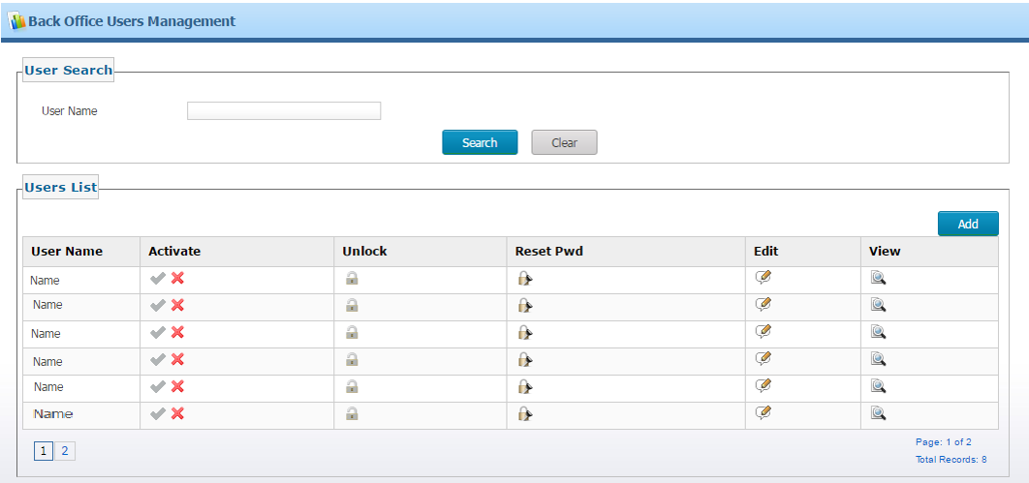
System Administration
The Back Office users’ management page: enables the responsible user to manage Back Office users by searching, creating, editing, activating/deactivating, unlocking, resetting password and viewing specific users.
Back

Slide 29
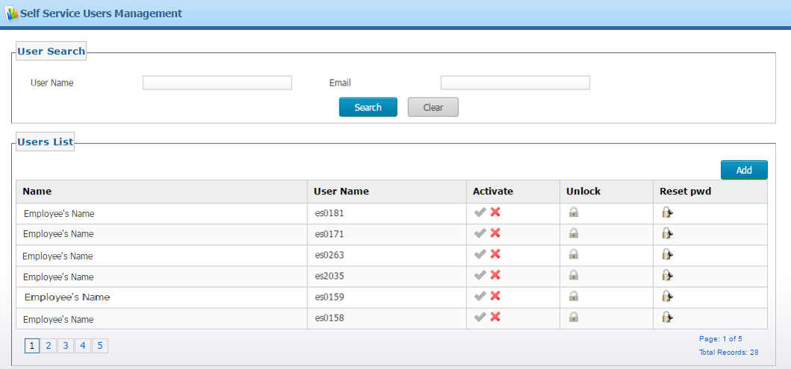
System Administration
The self-service users’ management page: enables the responsible user to manage online users by searching, creating, activating/deactivating, unlocking specific users and resetting passwords.
Back

Slide 30
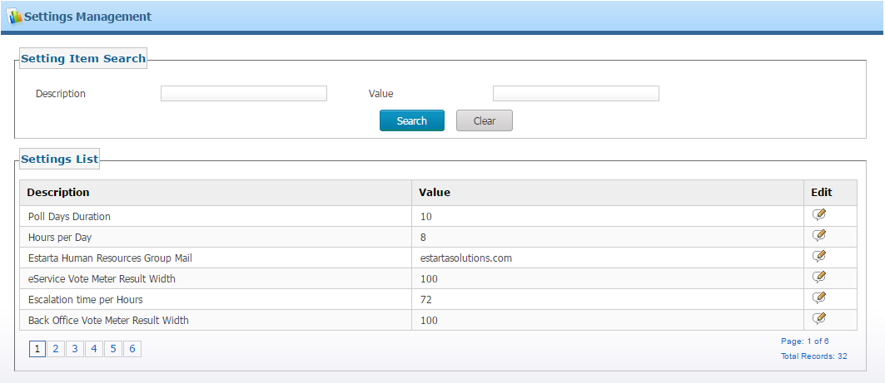
System Administration
The settings management page: enables the responsible user to manage all system settings and configuration values when needed.
Back

Slide 31
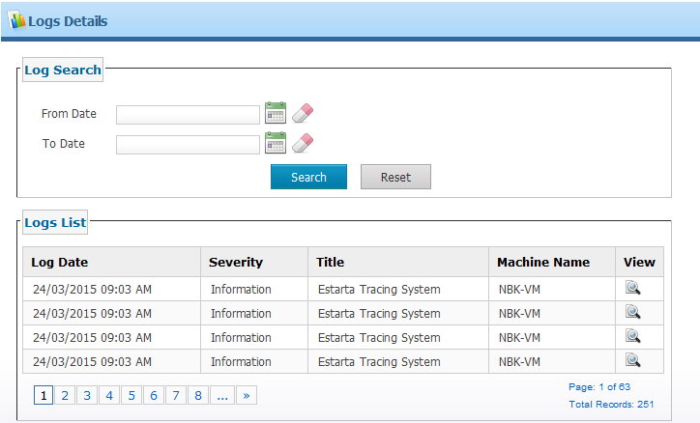
System Administration
The Logs Details page: allows the responsible user to view users’ logs in order to solve any issue that might occur by tracking the user logs and finding the exact issue, which will make solving the issue easier.
Back

Slide 32
Analytics
The analytics module is providing set of financial and human resources related reports related to the internal process, beside some of the reports related to the social security and taxation department official reports.
Headcount reports
Statistical reports
Financial reports
MIS reports
General reports
Back

Slide 33
Analytics
HR matrix: is an automated tool to extract the up to date demographic numbers of the organization over a monthly basis across one year
Back

Slide 34
Self Service
The self-service portal is an independent portal of the HRMS that provides front-end online services to enable the company’s online users to perform their activities in a systematic way.
Manager View
Employee View
Back

Slide 35
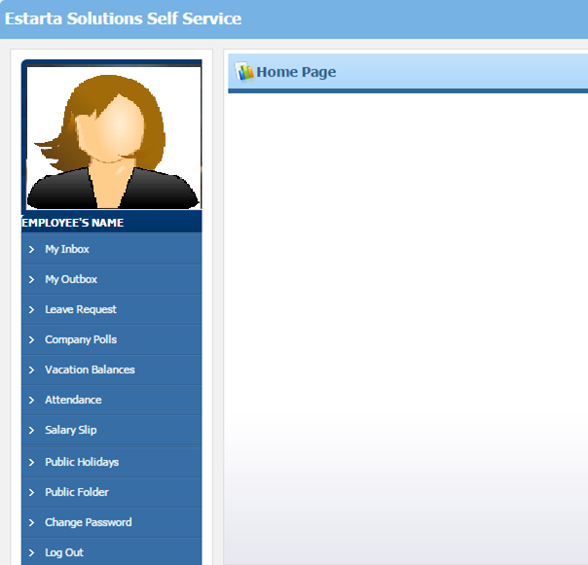
Self Service Cont.
The side screen shows the employee system view where the employee can view his/her profile by clicking on their name. Following are the main features for all employees:
My inbox
My outbox
Leave request
Company polls
Vacation balances
Attendance
Salary slip
Public holiday
Public folder
Change password
Back

Slide 36
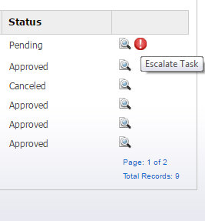
Self Service Cont.
My Inbox contains all the transactions received to the logged in user from others. Some transactions need an action to be taken, depending on the transaction and the logged in user privileges.
My Outbox contains all the transactions sent from the logged in user to others, if it’s in Pending status then it can be canceled. If the task stays in a Pending status after a specified period of time the employee can escalate it, if Approved then it can be reversed.
Back

Slide 37
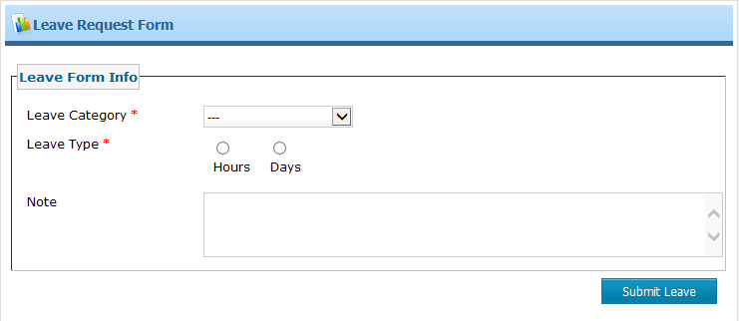
Self Service Cont.
The leave request is where the user can submit a leave within a specific category, such as the annual, unpaid or sick leave. The sick leave category has a mandatory attachment (medical report) to be uploaded by the user
The leave could be either of the Hours or the Days type where the user selects the leave time “from” when “to” when and the date of the leave. If the leave exceeds 3 hours the Note field becomes mandatory and should be filled with the leave reason
For the Days type, the user fills from which date to which date
Back

Slide 38
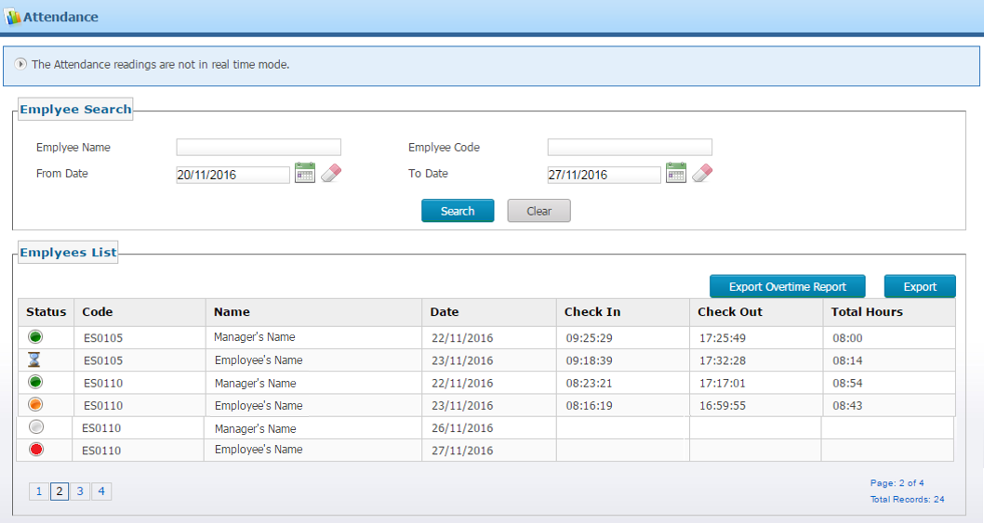
Self Service Cont.
Vacation balances is where the employee can check all the balances once the balance is entered by the HR team (annual, sick, other)
Attendance is where the employee can check his/her daily attendance once it’s uploaded by the HR team; if the logged in user is a manager he/she can check their employees’ attendance, whether for a specific employee or for a specific date
Back

Slide 39
Self Service Cont.
Salary slip is where the employee can check all their salaries once these salaries are uploaded by the finance team
Public holidays is the section where the employee can view the year’s public holidays as a calendar
Back

Slide 40
Self Service Cont.
The Public folder is where the self-service user can check the shared folders and files uploaded by the HR team:
Change password is the page where users can change their login password to a new one:
Back

Slide 41
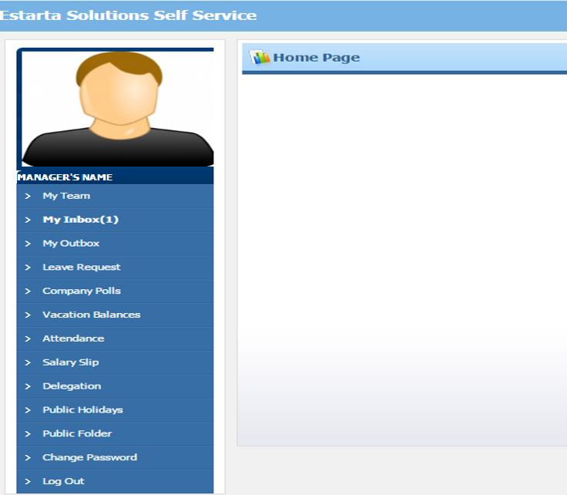
Self Service
Manager View:- a view for the managerial level. The side screen shows the managerial system view, where the difference is the addition of the following tabs to the regular employee view:
My team
Delegation
Back

Slide 42
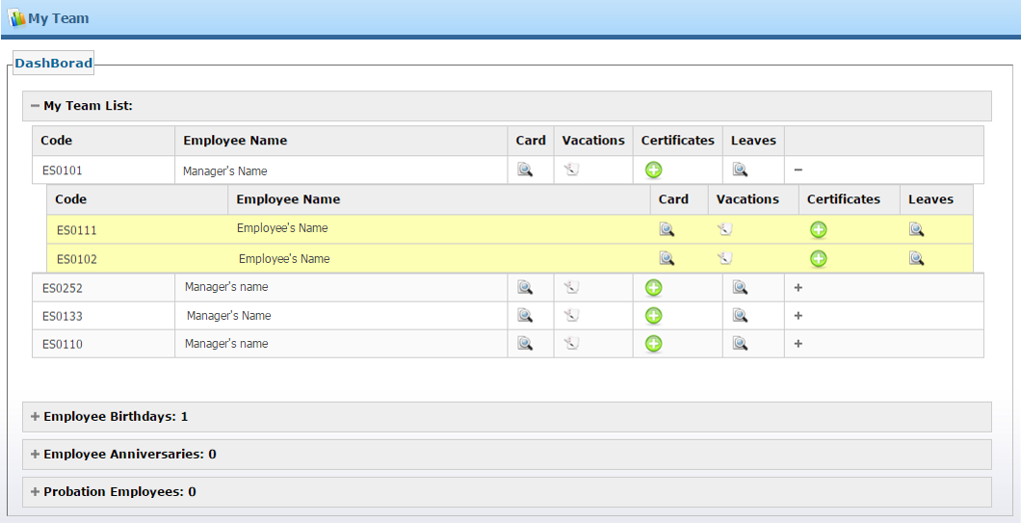
Self Service Cont.
My team is where the responsible user (manager) can have a quick view on his/her team list which contains the employee code, name, card, vacations, certificates, leaves, and any additional info, such as if the employee is in a manager role and in charge of other employees then his/her manager can check them too. Employees’ birthdays, anniversaries, 5th anniversaries and probation employees are shown here too.
Back

Slide 43
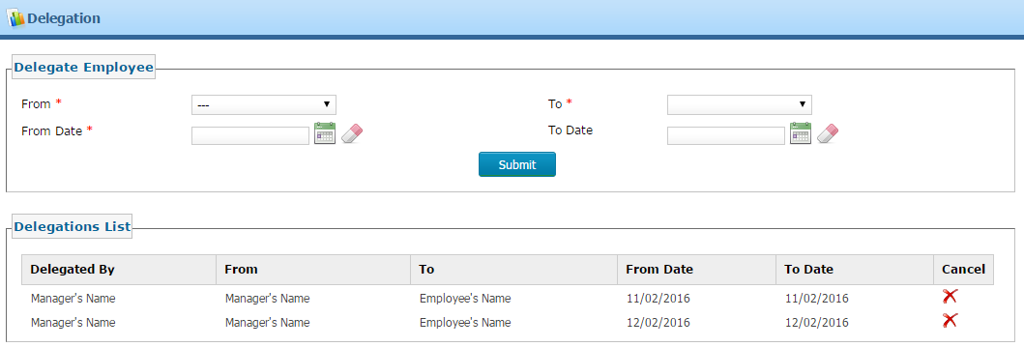
Self Service Cont.
Delegation is a management process where the manager can delegate his/her own tasks, or the tasks of the one who is unable to perform their tasks, whereby the manager is the delegator, to another one who is able to perform the delegated tasks within their team, the delegatee, with the privilege of taking actions on behalf of the delegator for a specific time period.
Back

Slide 44
Mail Notification
To make it easier to follow up on your inbox and all your processes, for any request received on My Inbox list an email will be sent to your email configured at the HR internal system -esHRMS- and you will be cc’ed to the email for any outgoing request from your side. The emails you will receive from the esHRMS are related to your:
Login Info
Reset password by the Administration
Leave submission, approval, rejection…etc.
Promotion submission, approval…etc.
Company polls
Back

Slide 45
Security
Due the sensitivity of the data being transmitted across the system, the esHRMS is using the cutting edge security standards when it comes to the communication protocol as it is exposed over Secure socket (SSL)
Related to the users and role management, strong password functions are used where all the user related info encrypted over the database.
For the self-service as it is exposed over the internet, CAPTCHA is required, where the communication is enabled only over https protocol. Yet the online user has restriction for the login failed attempts to prevent any credential hacking.
Back

